Slide 1
Dual Active Bridge

Slide 2
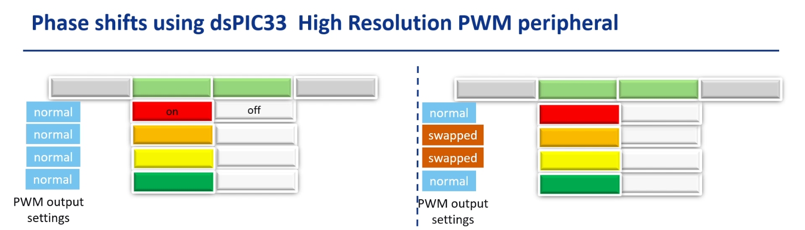
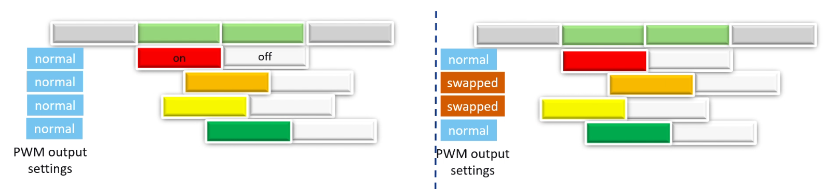
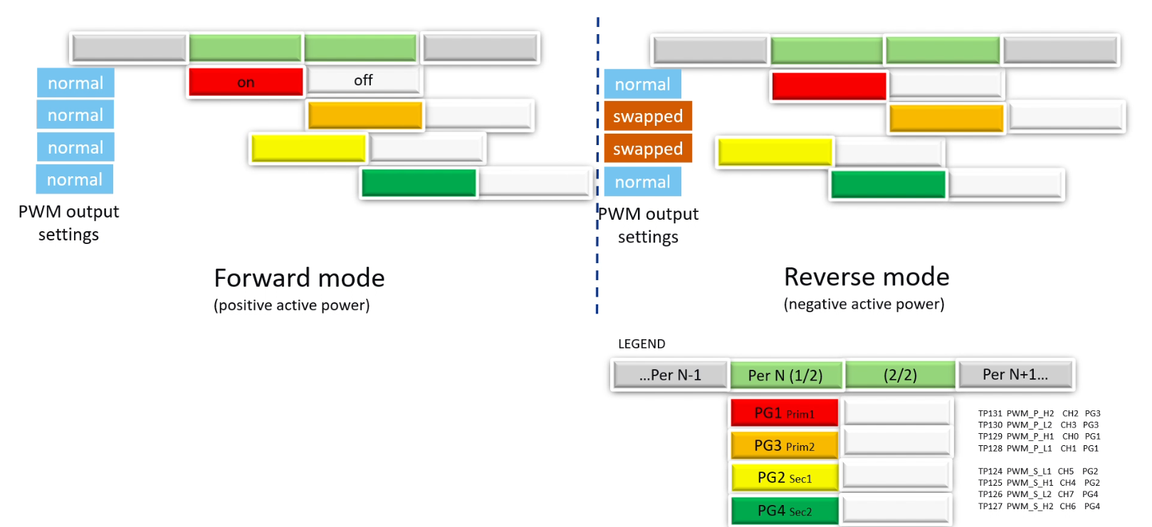

Slide 3
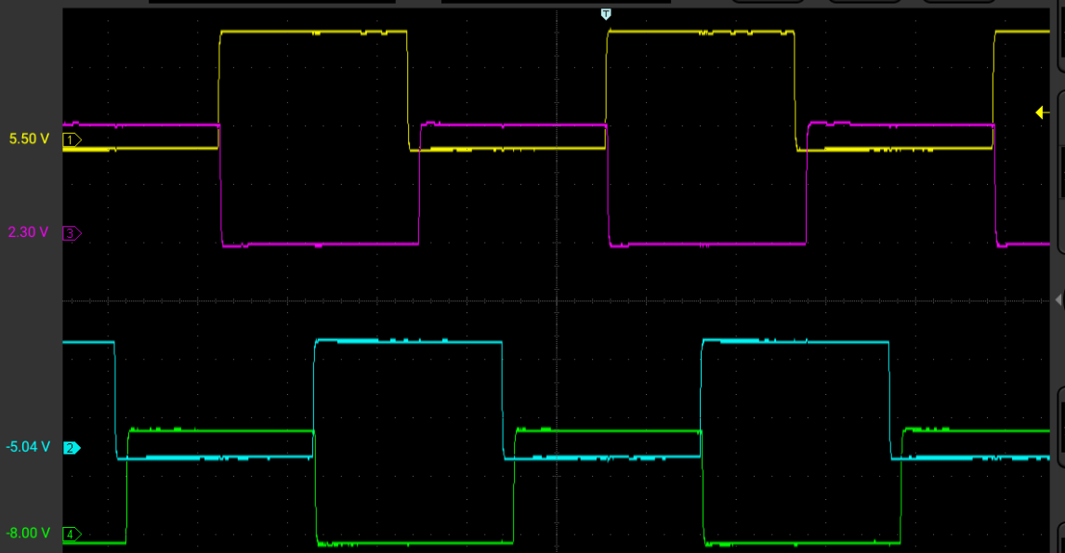
PWM Configuration – Cascaded PWM 1-2-3-4
PRItoSEC Phase 90 – (Bridge Phase / 2)
PWM1
PWM3
Bridge Phase 180 – 360 degrees
PWM2
PWM4

Slide 4
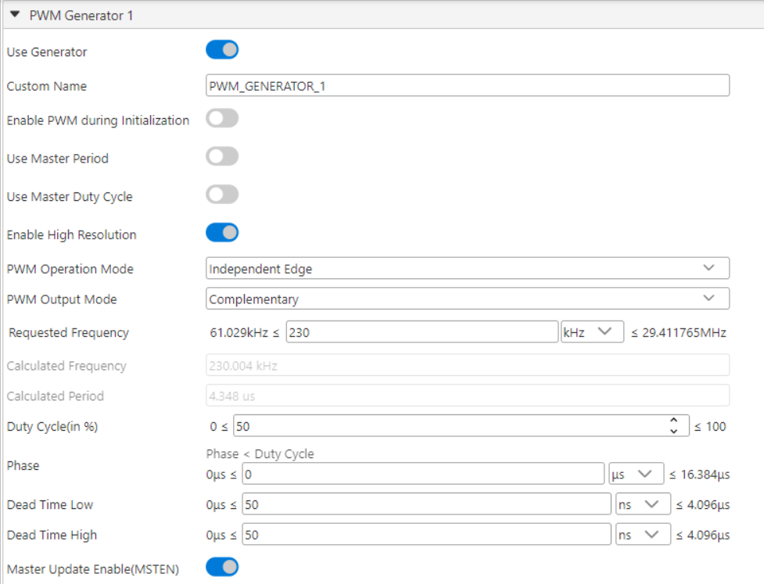
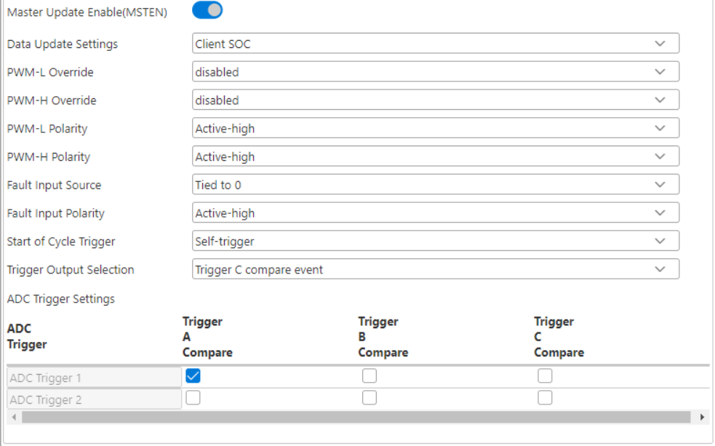
MCC PWM1

Slide 5
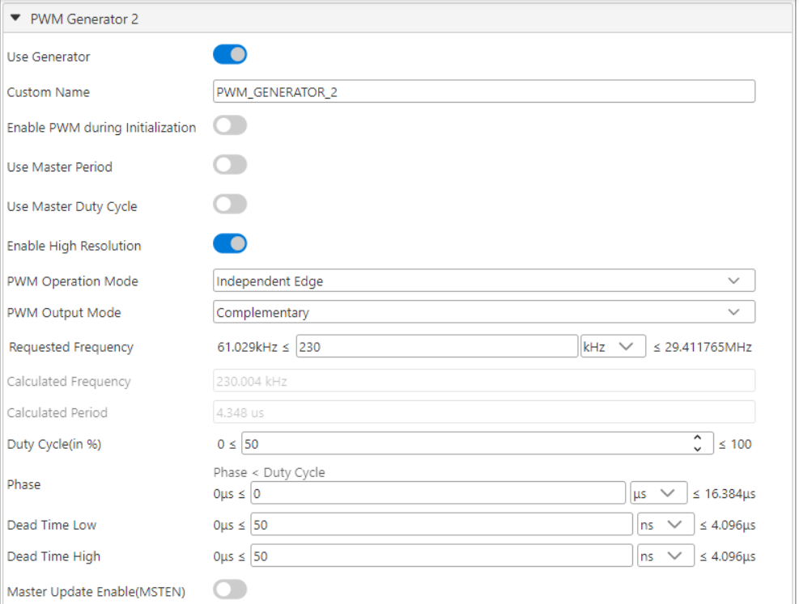
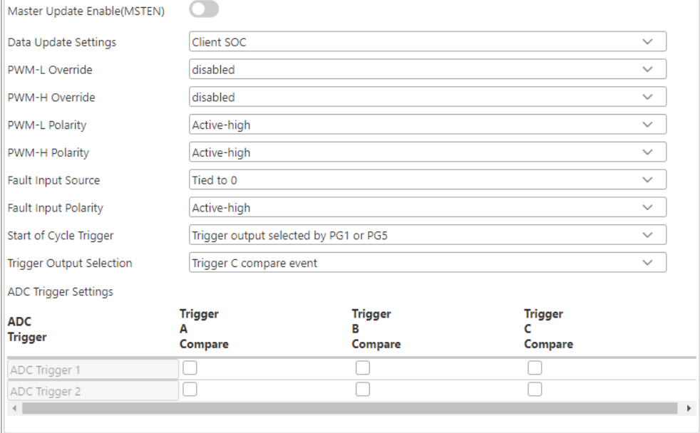
MCC PWM2

Slide 6
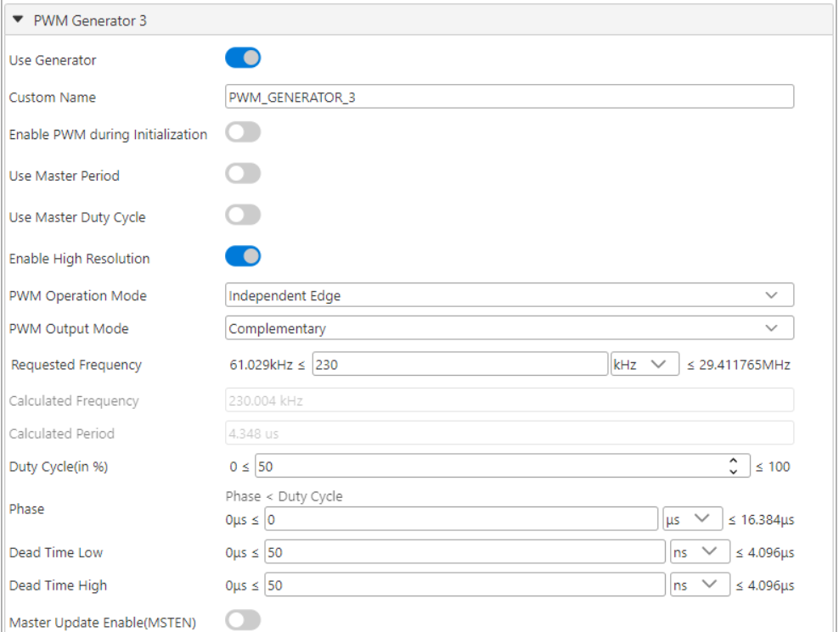

MCC PWM3

Slide 7
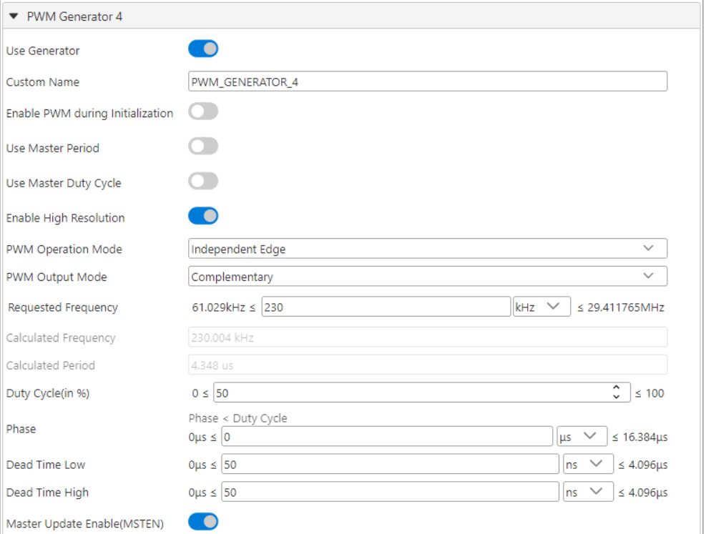
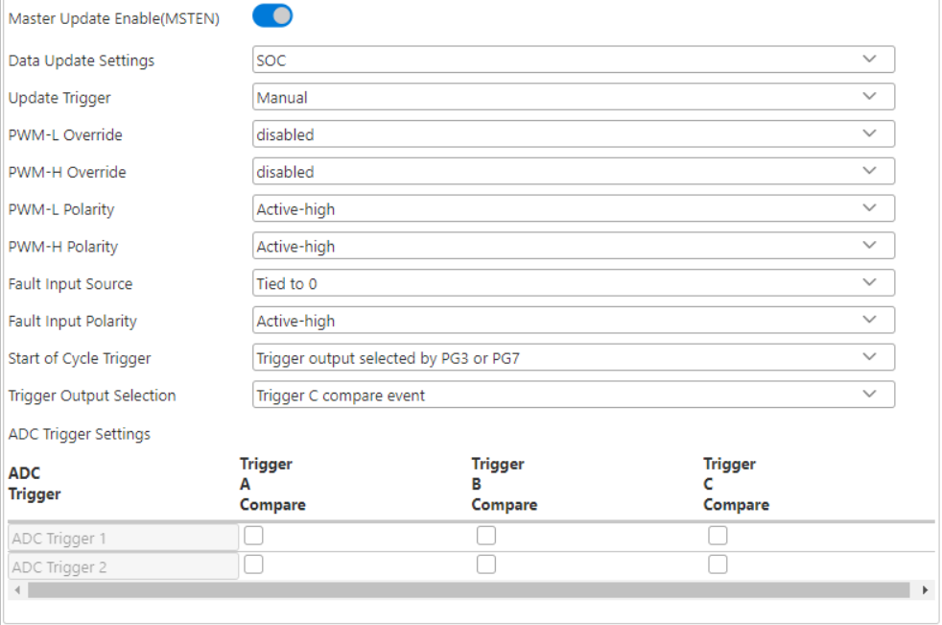
MCC PWM4

Slide 8
FB_Vdd-PWM_P fault implementation
SCCP2 input capture
CLC2
DMA2

Slide 9
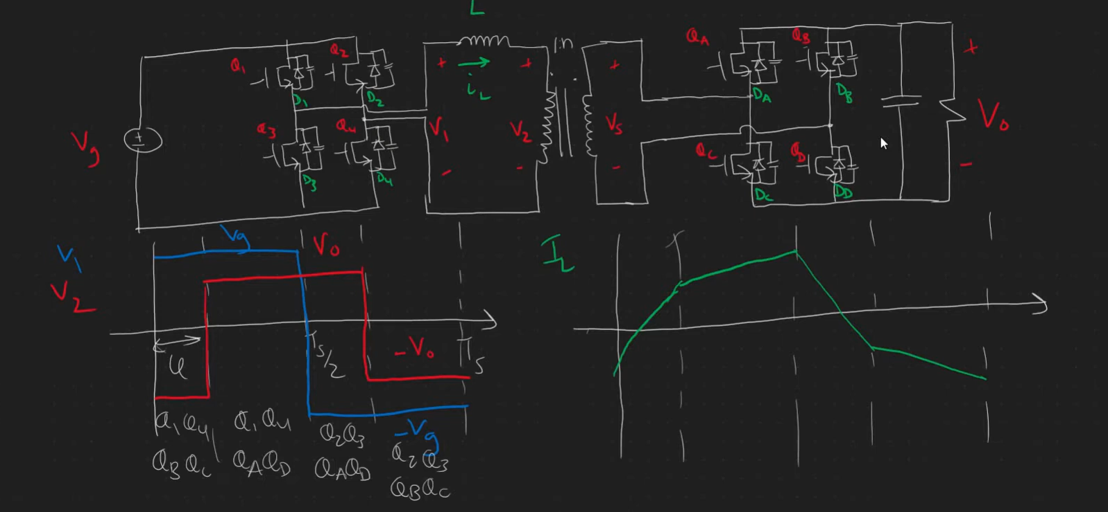
DAB operation

Slide 10
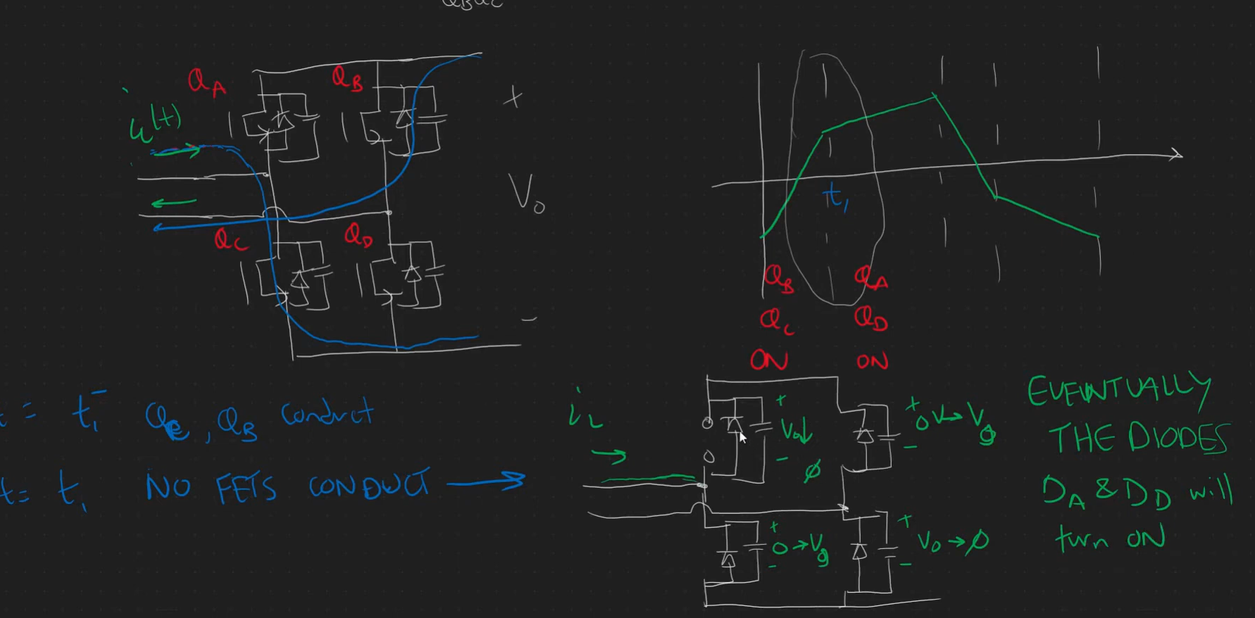
Inductor current naturally forces commutation of Diode

Slide 11
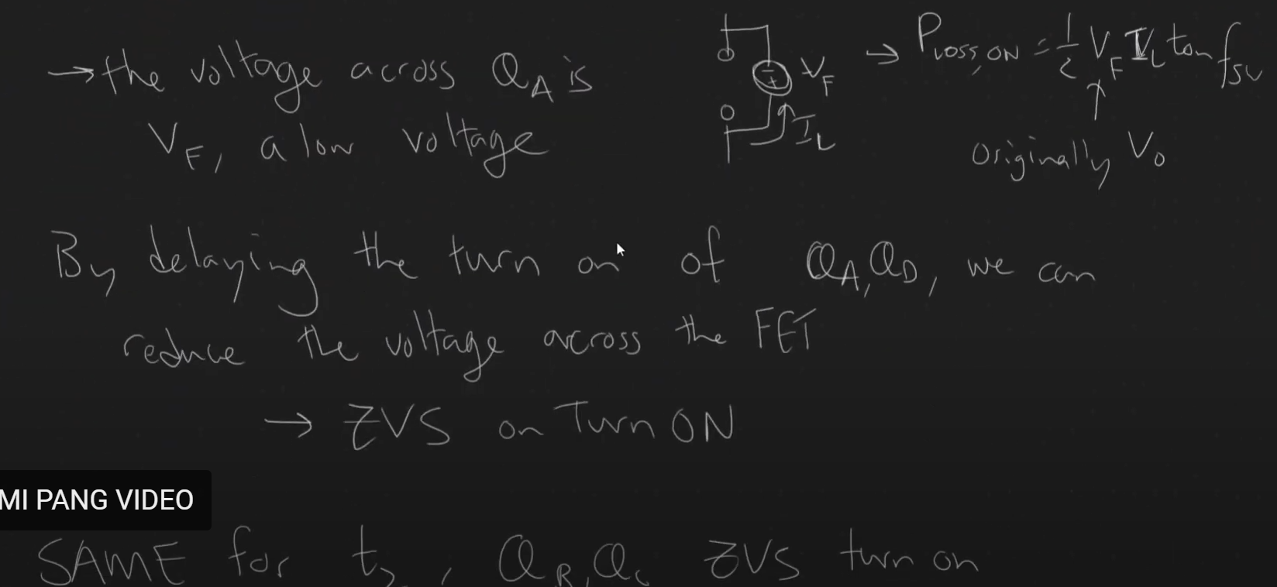

Slide 12
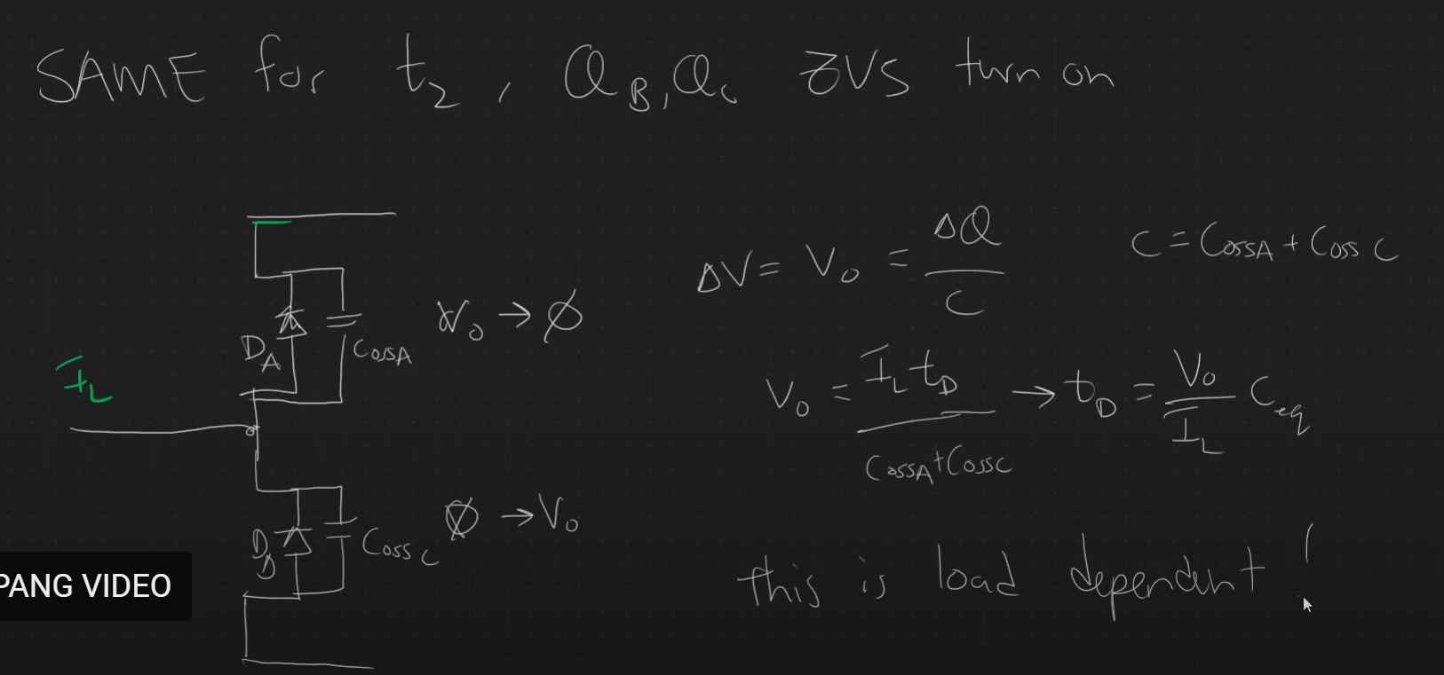
Deadtime equation for ZVS

Slide 13
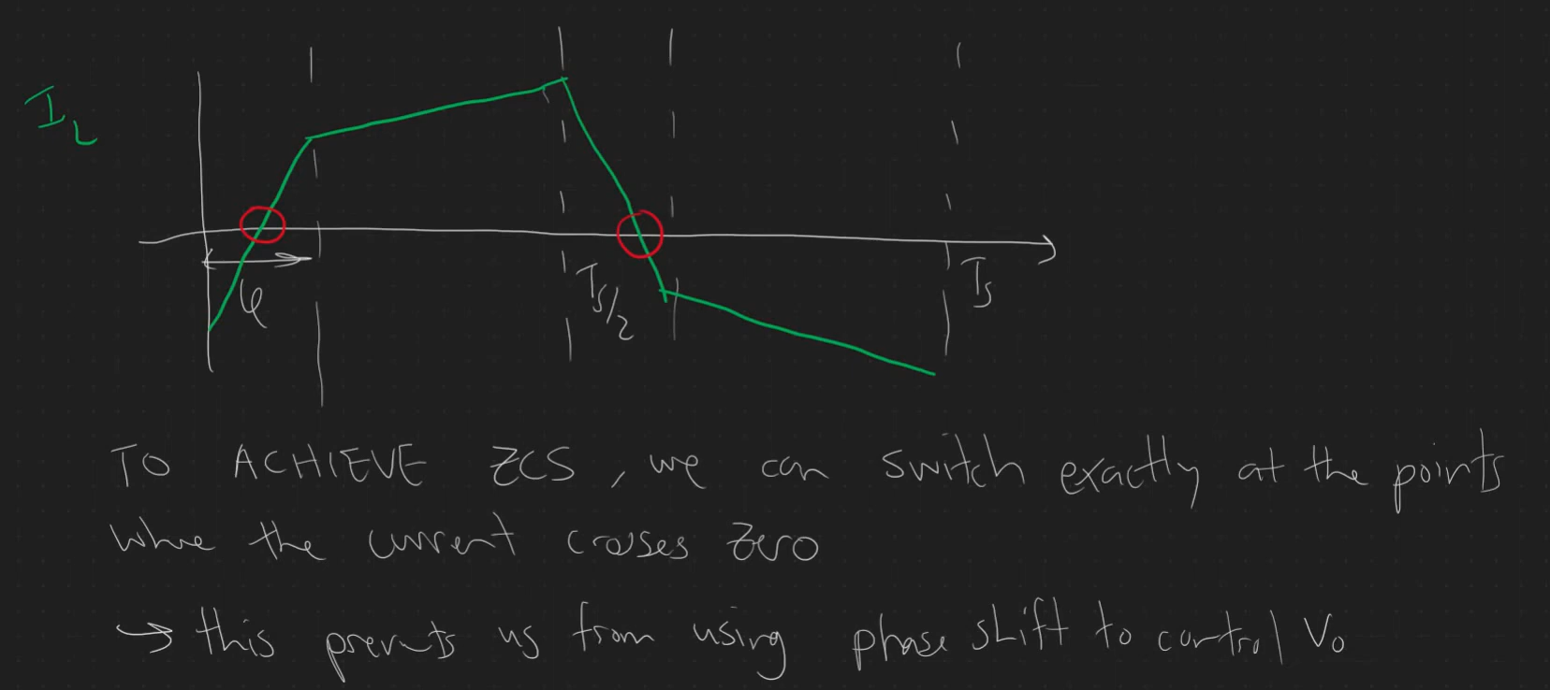
ZCS

Slide 14
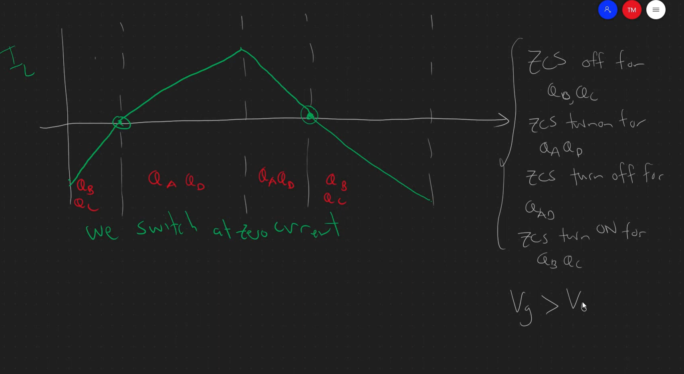
A new modulation to achieve soft switching ZCS

Slide 15
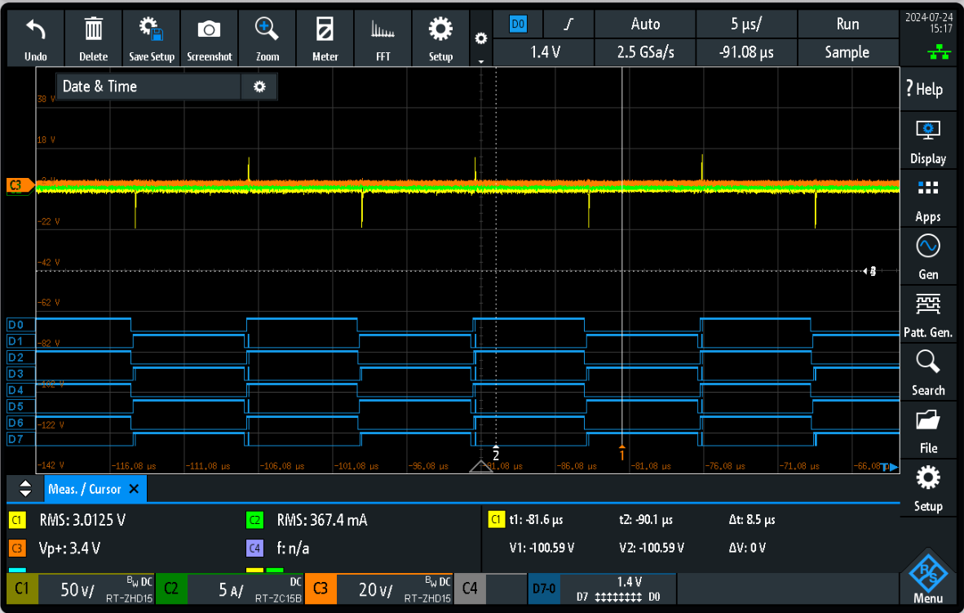
Actual testing to the DAB board in Garching (Open Loop measurement) – no Power flow
Control Phase: 0 degrees
Primary side PWM
PWM1: D0 D1
PWM3: D2 D3
Secondary side PWM
PWM2: D4 D5
PWM4: D6 D7

Slide 16
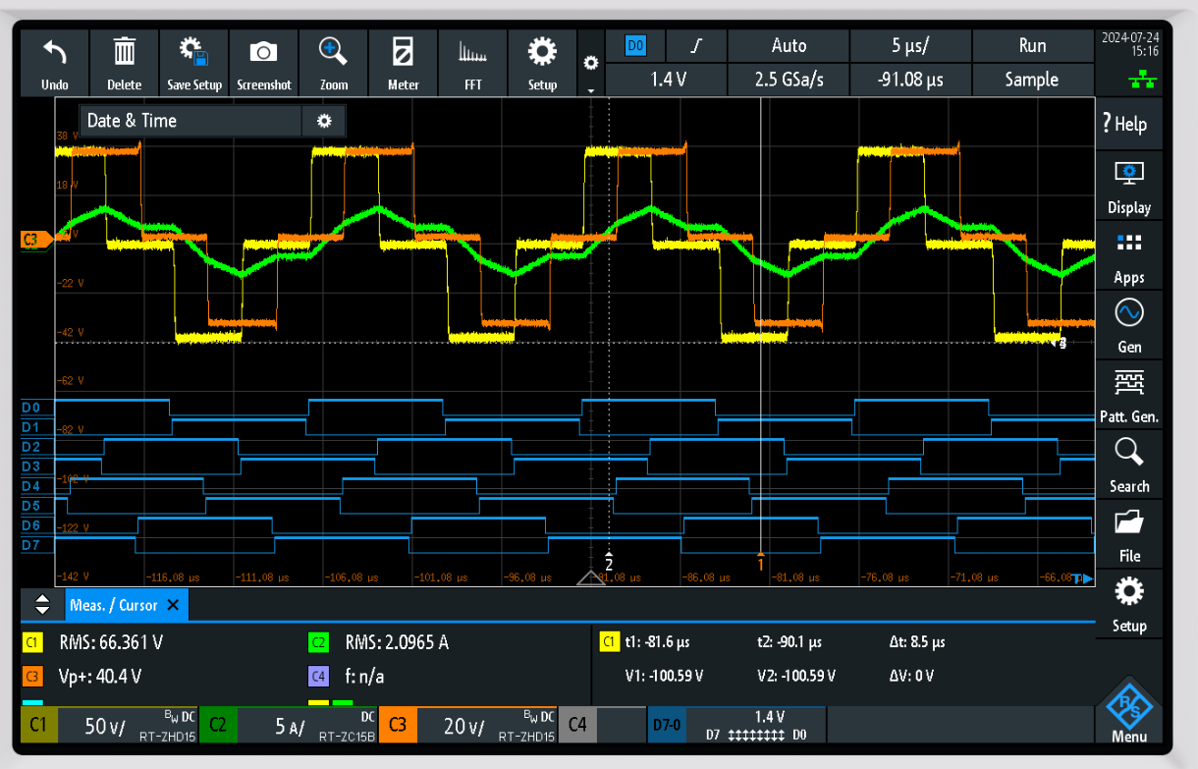
Actual testing to the DAB board in Garching (Open Loop measurement) – with Power flow
Control Phase: 90 degrees
Primary side PWM
PWM1: D0 D1
PWM3: D2 D3
Secondary side PWM
PWM2: D4 D5
PWM4: D6 D7
C1 – yellow (primary Bridge voltage)
C2 - green (transformer current)
C3 - orange (secondary Bridge voltage)

Slide 17
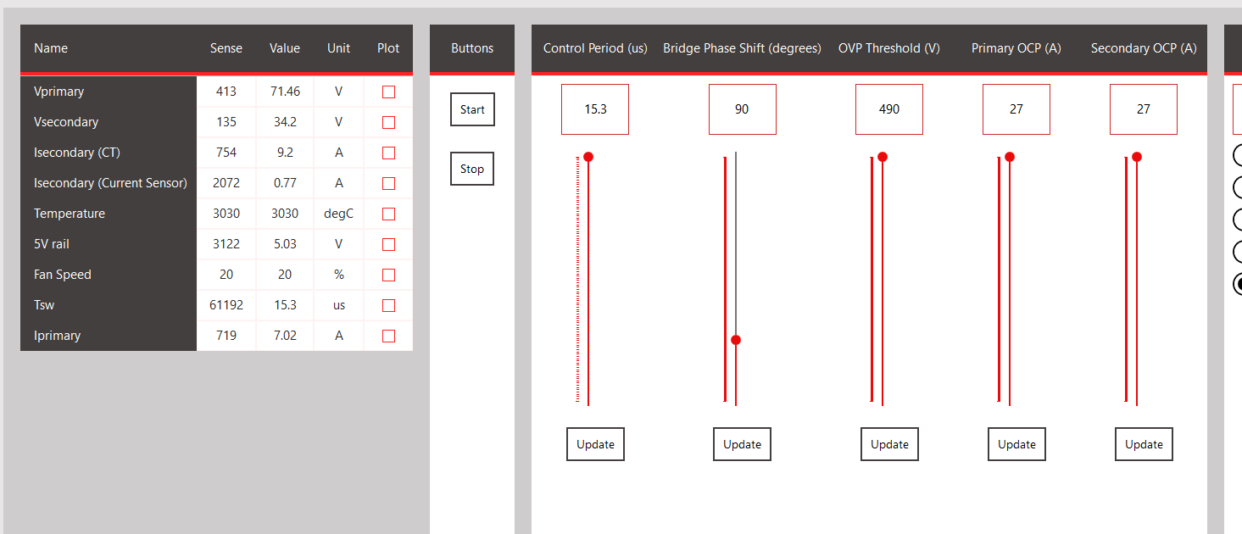
Actual testing to the DAB board in Garching (Open Loop measurement) – with Power flow

Slide 18
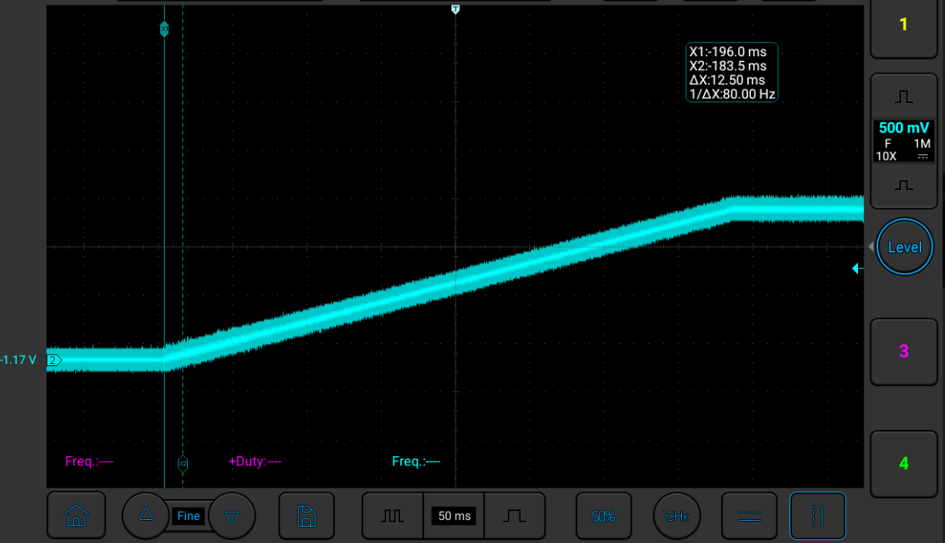
New ramp up –Vloop reference test

Slide 19
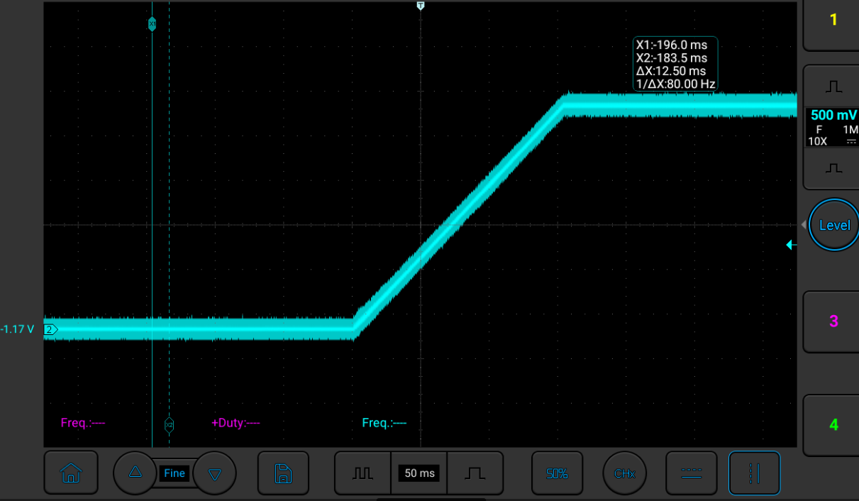
New ramp up –Iloop reference test

Slide 20
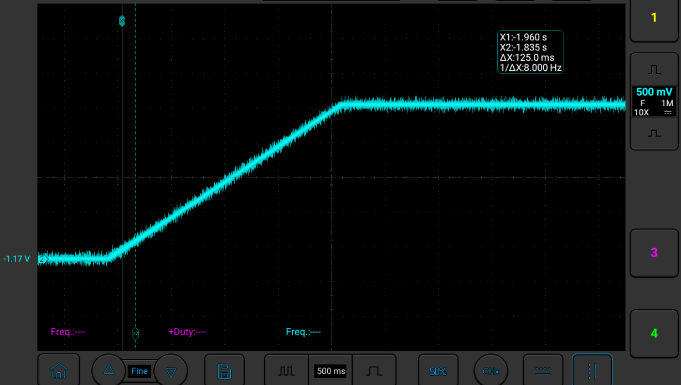
New ramp up –Ploop reference test

Slide 21
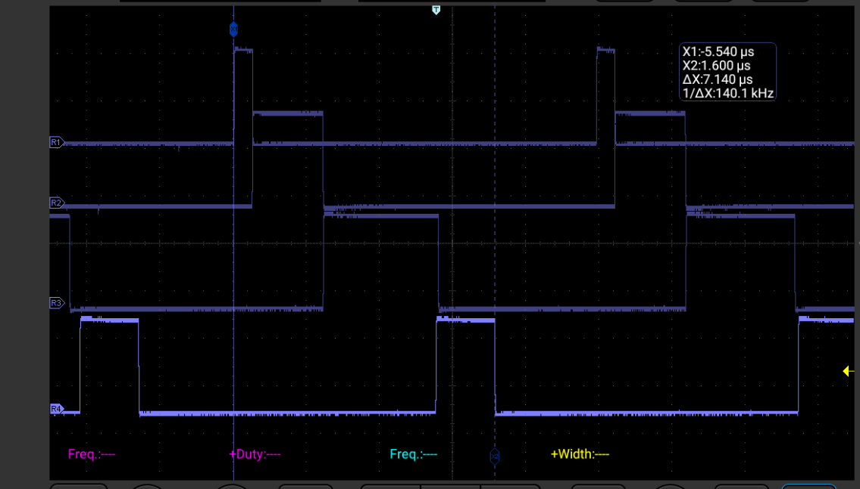
ISR timing tasks :: 100KHz execution time
ADC capture – 504.2 ns
Fault execute – 1.925 us
Control Loop IVP– 3.1 us
PWM distribution– 1.612 us

Slide 22
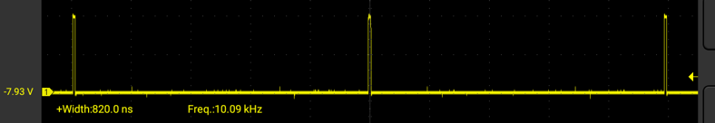
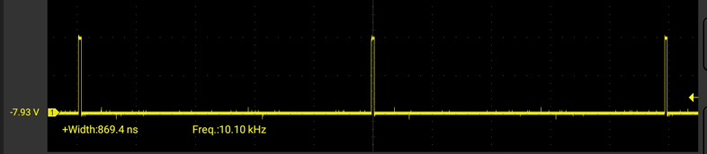
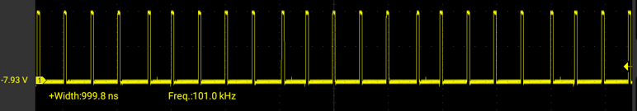
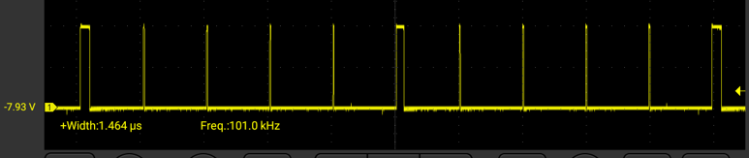
Control loop execution
Vloop
Ploop
Iloop
With averaging code
Interleaved execution
of Vloop and PLoop
Interleave switchover (127ns)

Slide 23
Firmware Structure

Slide 24
Firmware Structure
main.c file
System_Initialize
Power Control Initialize
Fault Initialize
main_tasks.c
Power Control Execute
Pwrctrl State Machine
MCC extension user configuration
Callback Initialization
OS_Scheduler
Tasks_100us
Fault Execute Fault Checks
Operating System Initialize
Power Board Visualizer Initialize
LED Initialize
Fan Initialize
Temperature Initialize
Tasks_1ms
PBV Task Uart Communication Handling
Tasks_10ms
Tasks_100ms
PBV Task
CAN Communication Handling
Tasks_1s
LED Execute Fan Execute Temperature Execute
Scheduler Run Forever
Watchdog Clear
PBV Task Uncritical PBV data
ISR::
ADC measurement Control Loop Execution PWM distribution

Slide 25
Firmware Structure
main.c file
System_Initialize
Power Control Initialize
Fault Initialize
main_tasks.c
Power Control Execute
Pwrctrl State Machine
MCC extension user configuration
Callback Initialization
OS_Scheduler
Tasks_100us
PBV Task Uart Communication Handling
Operating System Initialize
Power Board Visualizer Initialize
LED Initialize
Fan Initialize
Temperature Initialize
Tasks_1ms
PBV Task
CAN Communication Handling
Tasks_10ms
Tasks_100ms
LED Execute Fan Execute Temperature Execute
Tasks_1s
Scheduler Run Forever
Watchdog Clear
PBV Task Uncritical PBV data
ISR::
ADC measurement
Fault Checks Control Loop Execution PWM distribution

Slide 26
INITIALIZE
Initialize complete
FAULT DETECTION
No fault detected
Fault detected
STANDBY
Power Supply enabled
Fault detected
SOFT START
Voltage limit = Vtarget
Current limit = Itarget
Power limit =Ptarget
I/V/P target
changed
Fault detected
ONLINE (UP AND RUNNING)
Power Supply disabled

Slide 27
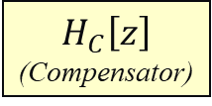
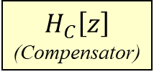
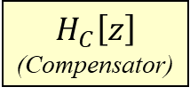
dsPIC33 device
dev_pwrctrl_isr.c
app_PBV
CCP
CAN
PBV comm
interface
ILimit
S
C
A
L
E
R
Voltage Feedback Loop (10KHz control interleaved with PLoop)
dev_fan.c
CCP
Fan
error
$$H_{C}\left[z\right]$$
(Compensator)
output
VLimit
+
-
dev_temp.c
input
Anti-Windup
Temperature
Sense
ADC
Power Feedback Loop (10KHz control interleaved with VLoop)
error
$$H_{C}\left[z\right]$$
(Compensator)
output
PLimit
+
-
input
Anti-Windup
REF
dev_pwrctrl_pwm.c
Current Feedback Loop (100KHz execution)
PWM Distribution
G_{P}(s)
(Plant)
PWM
V_{OUT}
t
Anti-Windup
error
$$H_{C}\left[z\right]$$
(Compensator)
dev_current_sensor.c
+
-
output
input
Current Sense
Voltage Divider
ADC
ADC
dev_pwrctrl_sm.c
State Machine
Hardware Fault
TIMER
CMP
GPIO
Soft-Start
V_{IN}
DAC
dev_led.c
Voltage Divider
Fault Protection
dev_fault.c
ADC

Slide 28
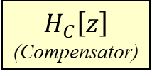
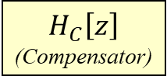
dsPIC33 device
dev_pwrctrl_isr.c
app_PBV
CCP
CAN
PBV comm
interface
ILimit
Voltage Feedback Loop (10KHz control interleaved with PLoop)
dev_fan.c
CCP
Fan
normalization
error
$$H_{C}\left[z\right]$$
(Compensator)
output
0-1
VLimit
+
-
dev_temp.c
input
Anti-Windup
Temperature
Sense
ADC
Power Feedback Loop (10KHz control interleaved with VLoop)
normalization
error
$$H_{C}\left[z\right]$$
(Compensator)
output
0-1
PLimit
+
-
input
Anti-Windup
REF
dev_pwrctrl_pwm.c
V_{IN}
Current Feedback Loop with AGC (100KHz execution)
PWM Distribution
G_{P}(s)
(Plant)
PWM
V_{OUT}
t
Anti-Windup
error
$$H_{C}\left[z\right]$$
(Compensator)
dev_current_sensor.c
+
-
output
input
Current Sense
Voltage Divider
ADC
ADC
dev_pwrctrl_sm.c
Voltage Divider
State Machine
Hardware Fault
TIMER
CMP
GPIO
Soft-Start
DAC
dev_led.c
Fault Protection
dev_fault.c
ADC

Slide 29
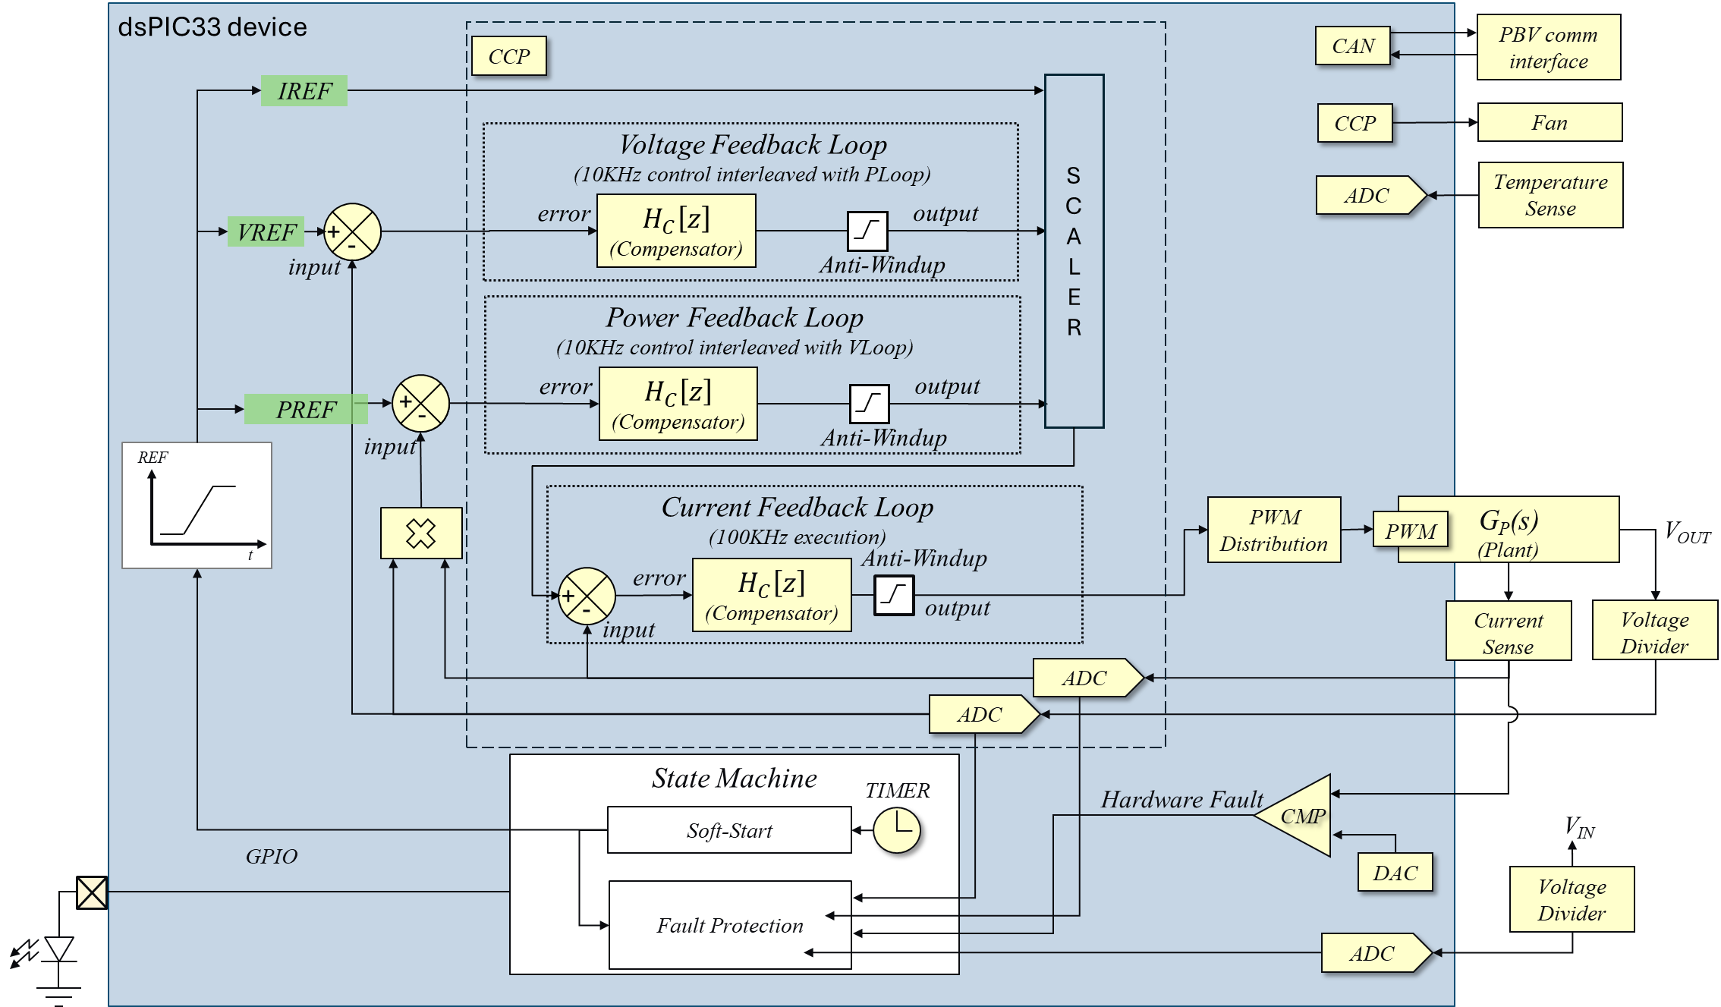
Firmware Block Diagram

Slide 30
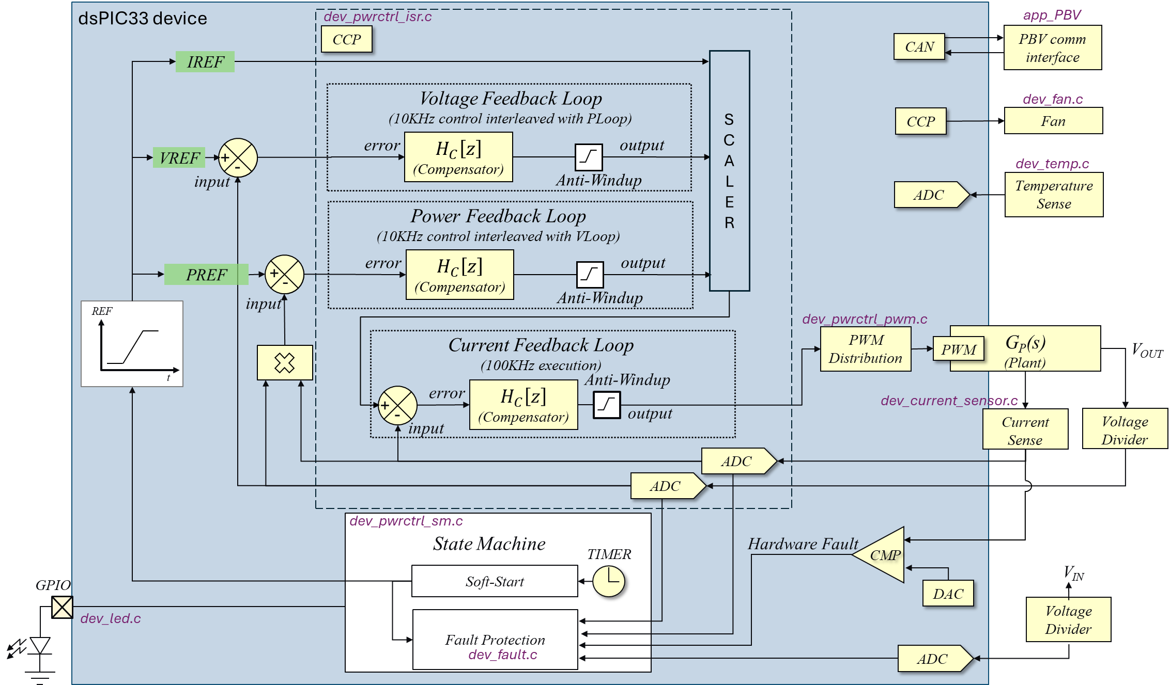

Slide 31
Fault | Trigger Threshold | Clear Threshold | Blanking Time | Clear Time
Input Over Voltage Protection | 700V | 600V | 0s | 0s
Output Over Voltage Protection | 490V | 20V | 1ms | 10ms
Primary Over Current Protection | 39A | 2A | 50us | 0s
Secondary Over Current Protection | 49A | 2A | 50us | 0s
Over Temperature Protection | 80˚C | 75˚C | 400ms | 400ms
5V Rail Under Voltage Protection | 3.5V | 3.8V | 50us | 0s

Slide 32
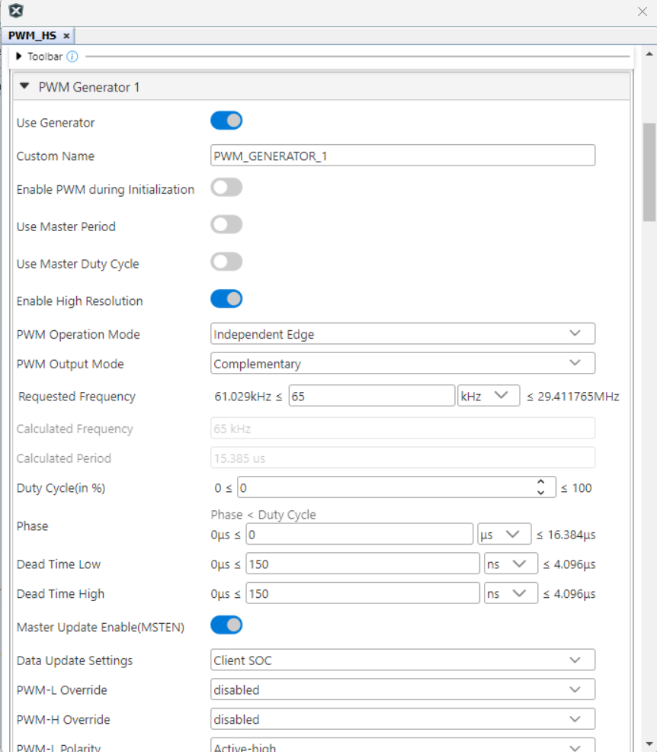
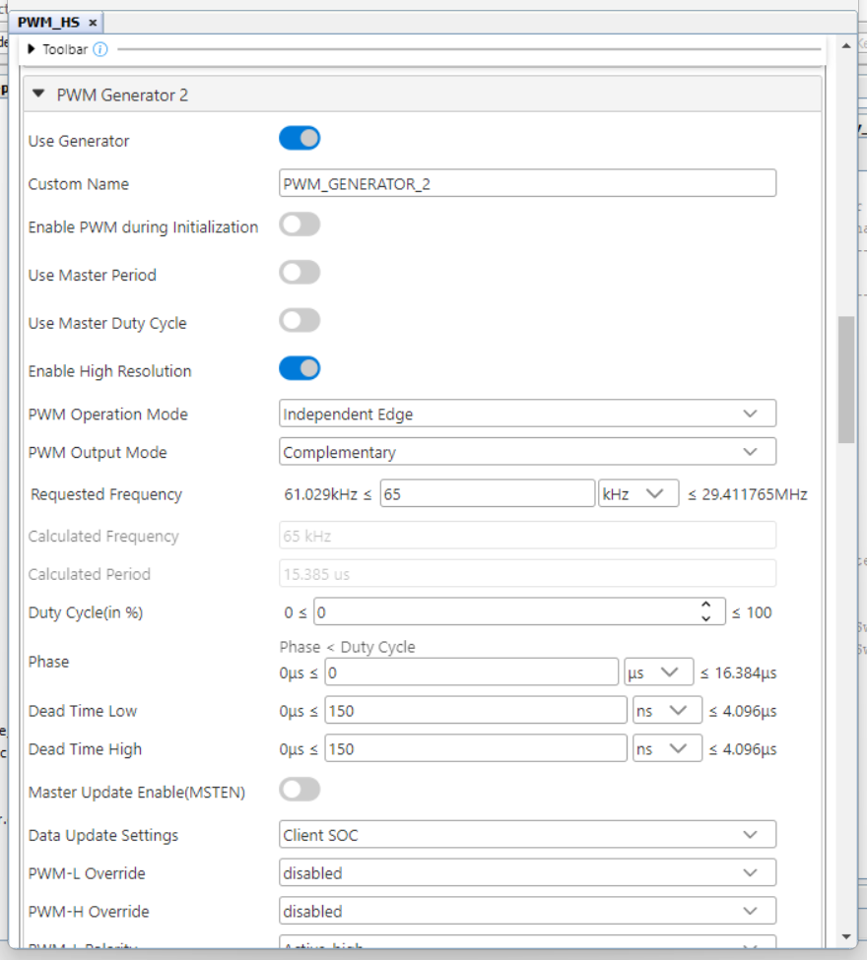
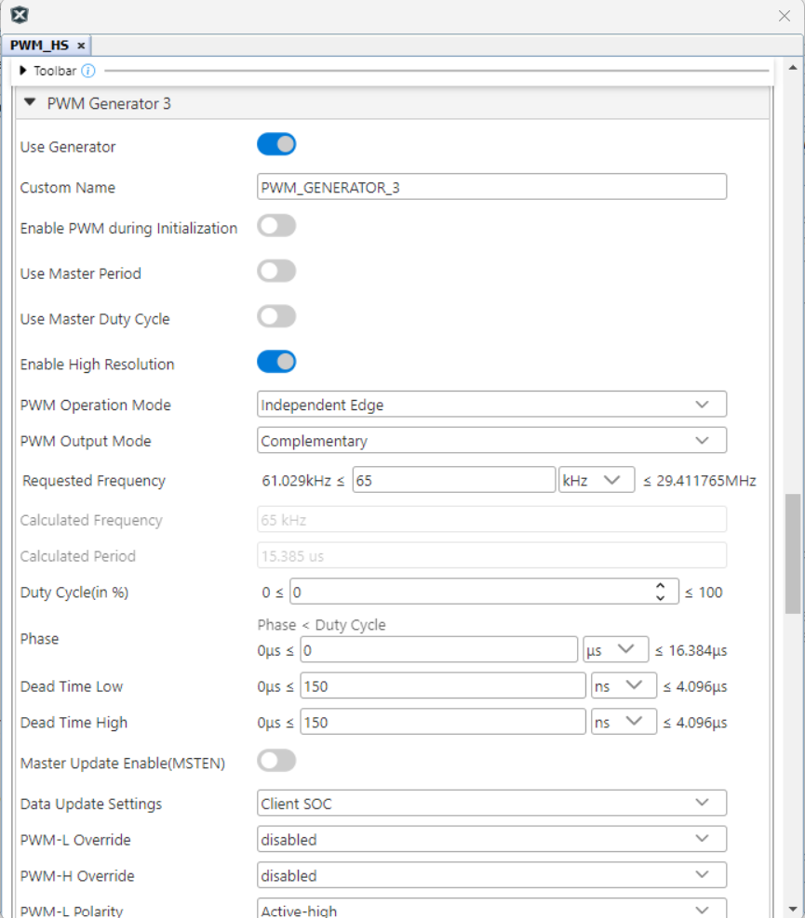
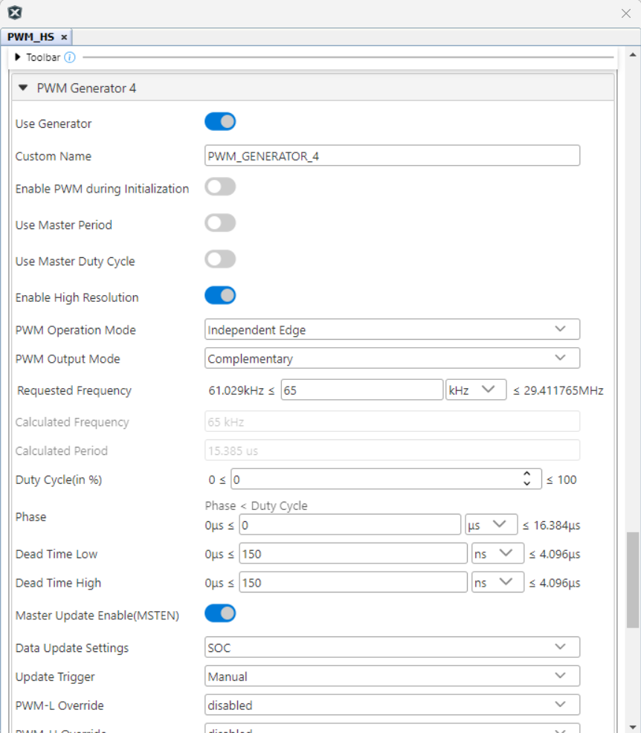
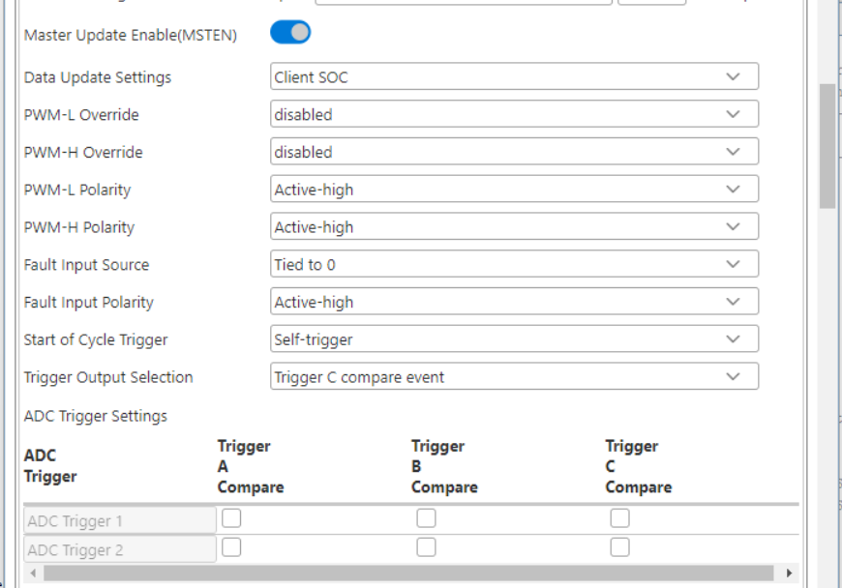
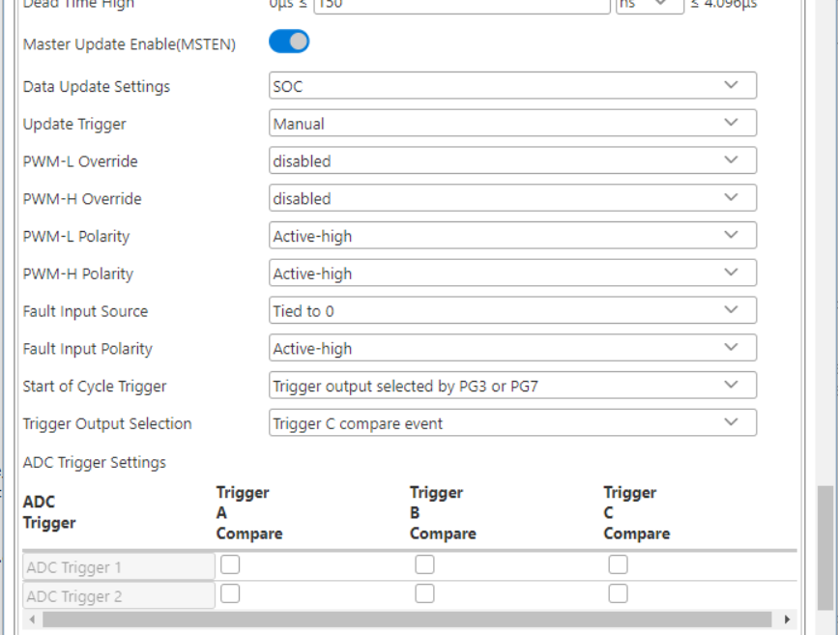
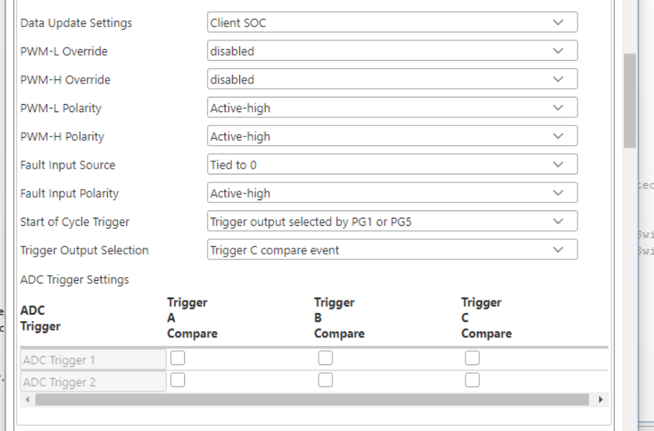
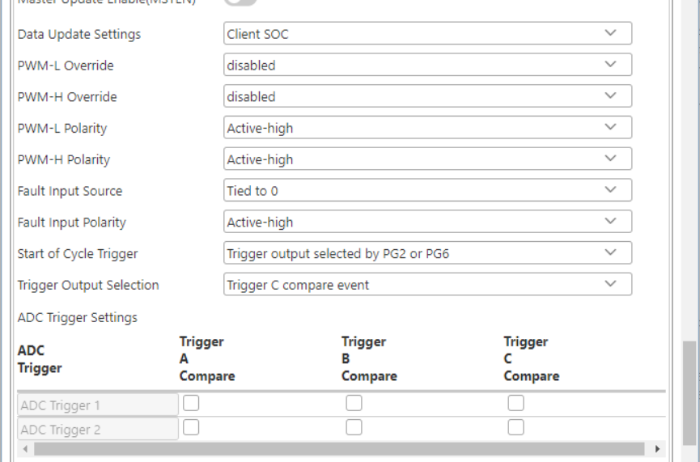

Slide 33
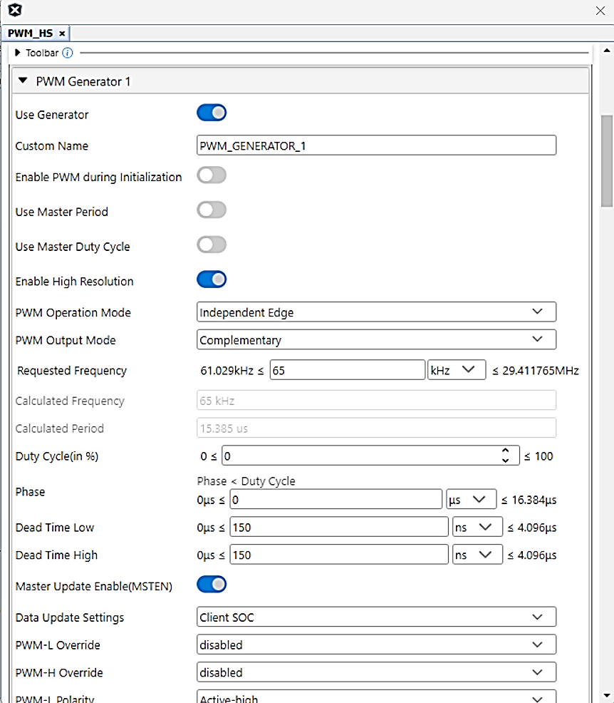
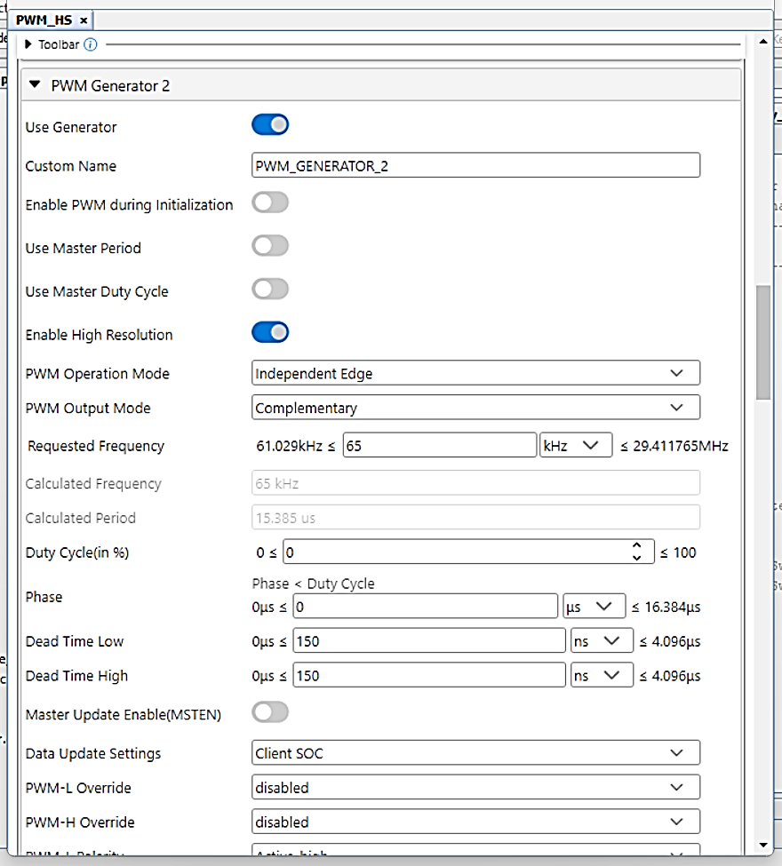
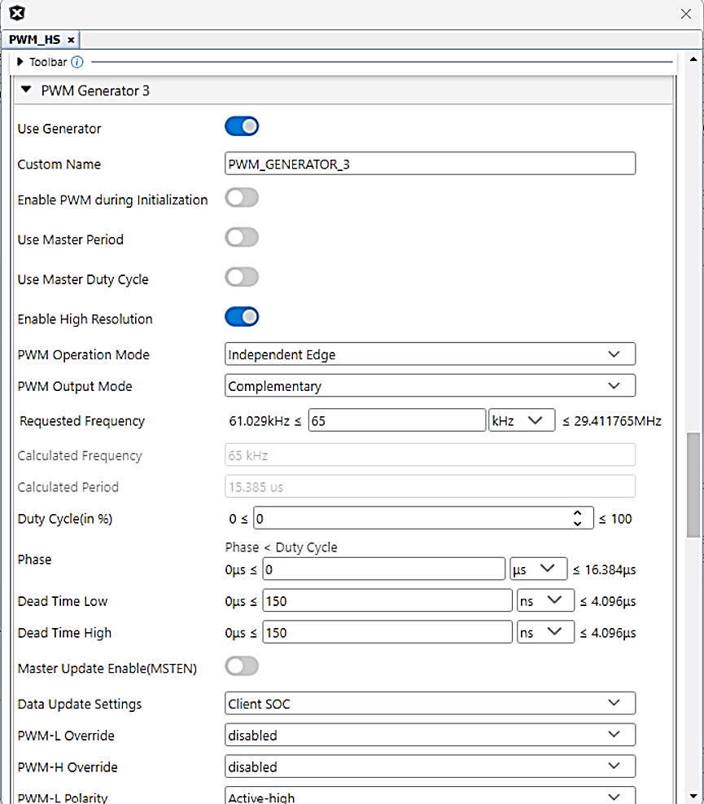
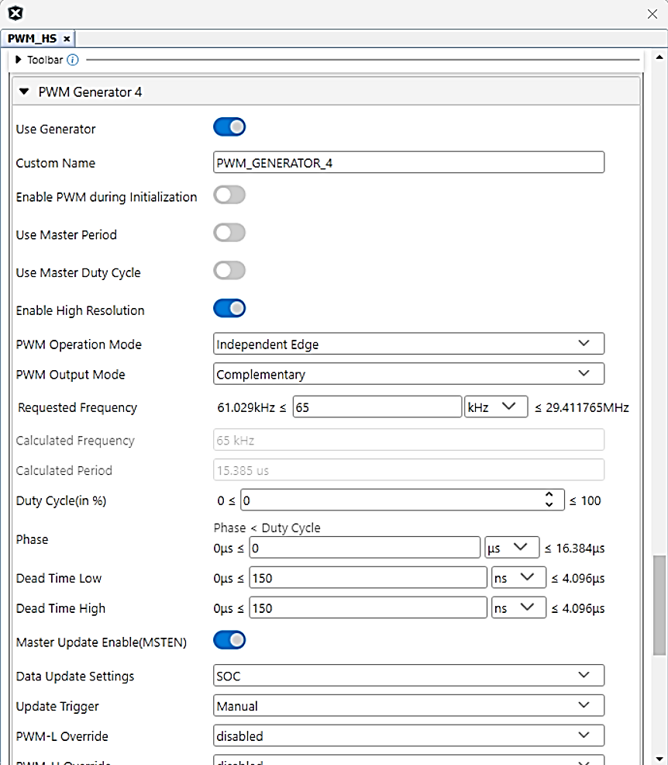
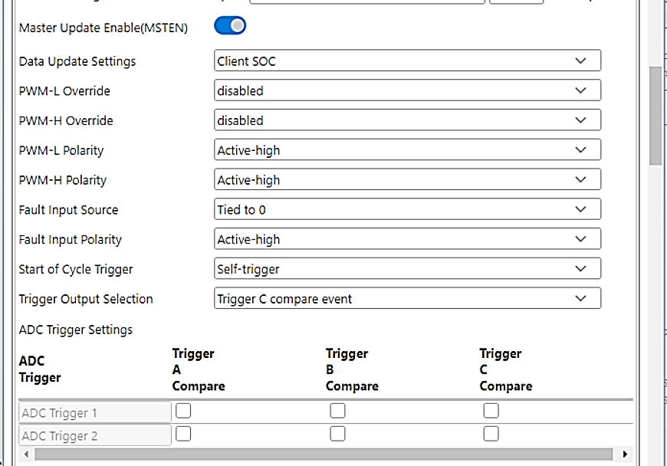
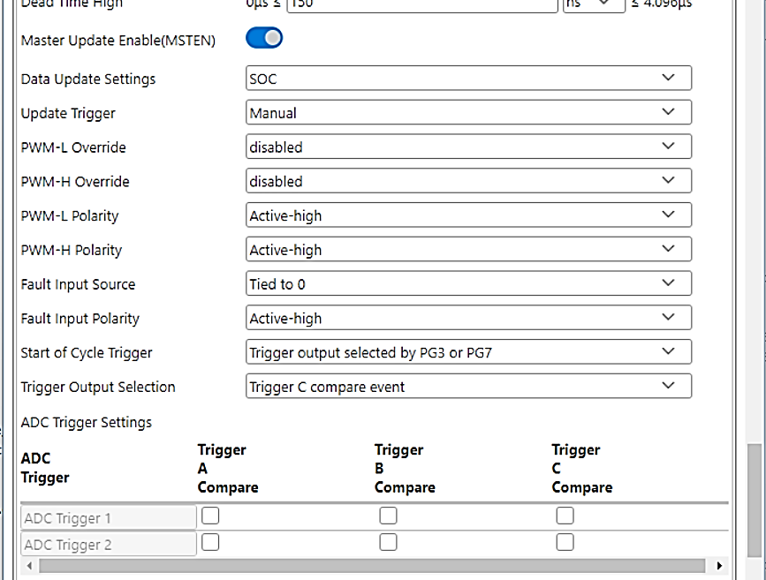
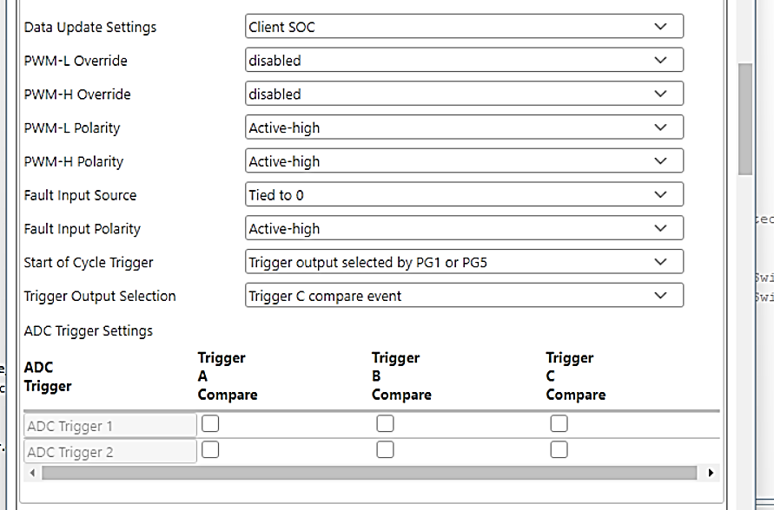

PWM Bridge A Primary
PWM Bridge C Secondary
PWM Bridge B Primary
PWM Bridge D Secondary

Slide 34
PWM Configuration – Cascaded PWM 1-2-3-4
PRItoSEC Phase 90 – (Bridge Phase / 2)
PWM1
PWM3
Bridge Phase 180 – 360 degrees
PWM2
PWM4

Slide 35
PWM Configuration – Cascaded PWM 1-2-3-4
PWM1
PWM3
PWM2
PWM4

Slide 36



Slide 37

DAB Garching test

Slide 38


Slide 39
Deadtime checking

Slide 40



Slide 41
Pri-Sec
Phase shift
PWM1L
PWM1H
PWM3H
PWM3L
PWM2L
PWM2H
PWM4H
PWM4L

Slide 42


Slide 43



S2
S1
S3
S4
Reference: IEEE Closed-loop Control of Isolated Dual Active Bridge
Converter using Dual Phase Shift Modulation
Notes:
Modulating in primary side; same amount of phase shift also in secondary side
Phase shift gives rise to a positive
Power in the inductor is proportional to the width

Slide 44
Yellow: Primary bridge
Orange: Secondary bridge
Green: Primary current
Purple: Secondary current
Inductive behaviour
Capacitive behaviour

Slide 45

Notes:
TPS example – ZVS and total rms value is much better at DPS

Slide 46

C1: Primary Voltage Bridge
C2: Primary Current
C3: Secondary Voltage Bridge
C4: Secondary Current

Slide 47

PWM1H
soc
PWM3H
soc
PWM2H
PWM4H
soc

Slide 48

PWM1H
soc
PG2TRIGC
PWM3H
soc
PWM2H
PG1TRIGC
soc
PWM4H
PG3TRIGC

Slide 49
Remaining tasks for DAB
Cleanup XML – will be done before September 30
Cleanup Debug codes – will be done before September 30
Final reorganization of FW directory structure – will be done before September 30
Final readme – will be done before September 30
Validation at full power (11KW) –TBD
Testing the power loop robustly (do not know yet how to measure the bode in this mode)
Fault protection enchancement
Discharging mode -TBD
OBC mode-TBD
Frequency Modulated (not fully implemented) -TBD

Slide 50
Next Quarter Tasks
MINDI simulation for LLC and PFC midpoint compensation
Plant measurement for CLLC
Code migration for single phase PFC A core part
Other DAB tasks

Slide 51


Slide 52

1
4
2
5
3

Slide 54
With reverse mode operation

Slide 55

1
4
2
5
3

Slide 56

Power Board Visualizer bidirectional xml version

Slide 57

Power Board Visualizer bidirectional xml version

Slide 58

Power Board Visualizer bidirectional xml version

Slide 59

DAB Bidirectional DCDC – Block diagram of Hardware (TSS)
Isolated Voltage sense is powered by voltages higher then 100V on primary side. Anything lower, circuit is not working reliable. Careful ramp up sequence is mandatory to avoid dangerous overshoot when starting reverse mode operation.
Notes:
Total System Solutions approach:
4 half bridges are implemented using Microchip SiC mosfets (Plug In Module)
Main control elements hinge around high speed pwm module from a dsPIC33C or dsPIC33A device carried on a Pulg In Module
Various other utility semiconductors made by Microchip across board
Isolated voltage sense, auxiliary power regualtors, CAN interface etc.
Payton: Shim Choke + Transformer
Wurth: HW DC link capacitors

Slide 60


Typical waveforms fwd. vs rev. Simplified TPS modulation
Forward mode
(positive active power)
Reverse mode
(negative active power)
Notes:
Oscilloscope waveform capture:
Orange – primary AC voltage
Yellow – secondary AC voltage
Purple Blue – Current waveform in inductor and transformer
Blue – logic analyzer . 4PWM signals PG1 .. PG4 high side (the other 4 are simply complementary, so they have been left out for less clutter)
Comparison of Forward and Reverse operation
Observe the 180° phase difference for current waveform.
This translates to positive or negative active power flow

Slide 61

Forward mode (positive active power)

Slide 62

Reverse mode (negative active power)

Slide 63


Slide 64
Gk: Current loop gain factor must be used to keep current gain constant while Vin varies.
Direct consequence of Gyrator operating mode.

